Slide 1




Randomness in Computing
LECTURE 9
Last time
Computing the median of an array
Today
Chernoff Bounds
CS
537
Sofya Raskhodnikova;Randomness in Computing

Slide 2
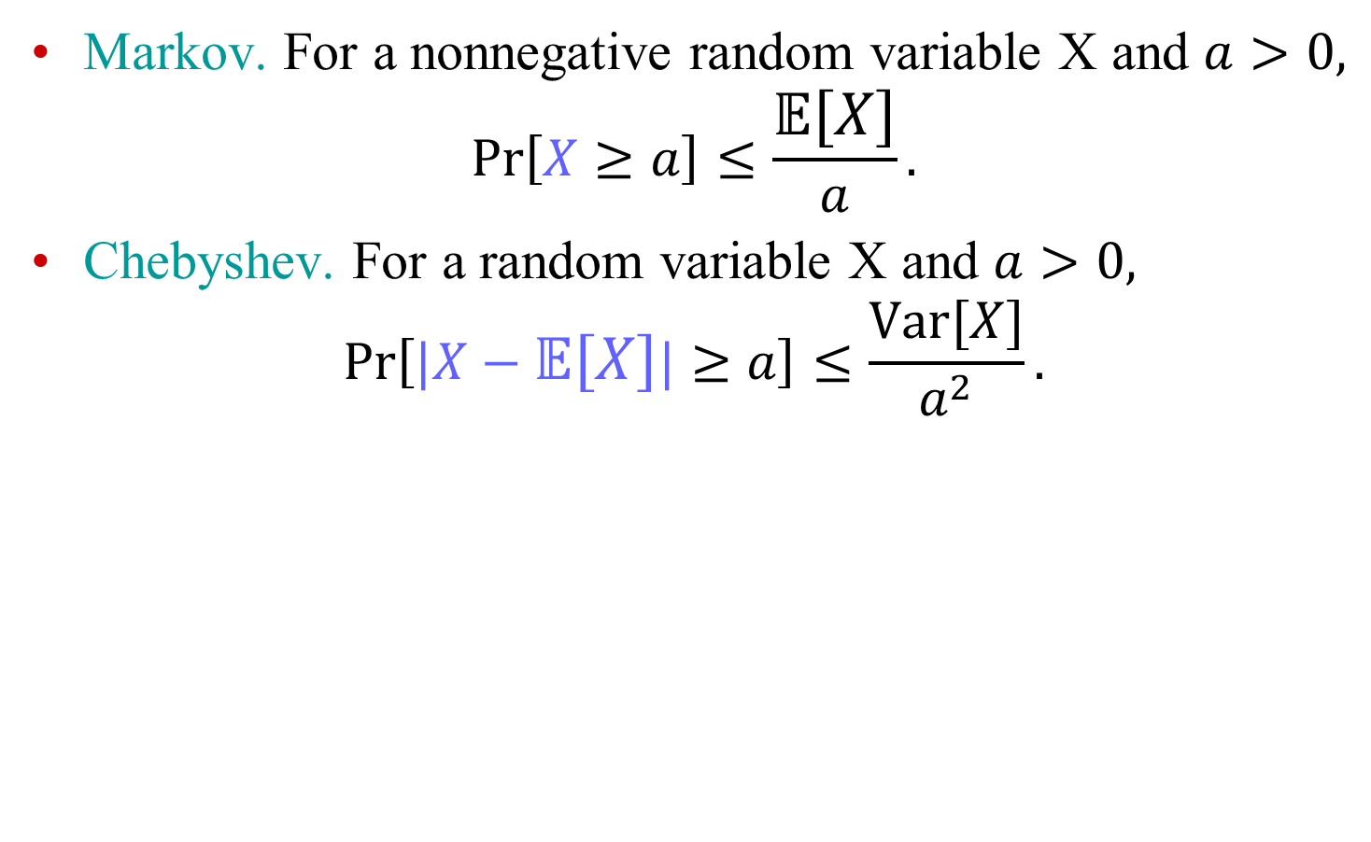
Tail Bounds So Far
Markov. For a nonnegative random variable X and $a>0,$
$$\operatorname{Pr}\left[X≥a\right]≤\frac{𝔼\left[X\right]}{a}.$$
Chebyshev. For a random variable X and $a>0,$
$$\operatorname{Pr}\left[|X−𝔼\left[X\right]|≥a\right]≤\frac{Var[X]}{a^{2}}.$$

Slide 3
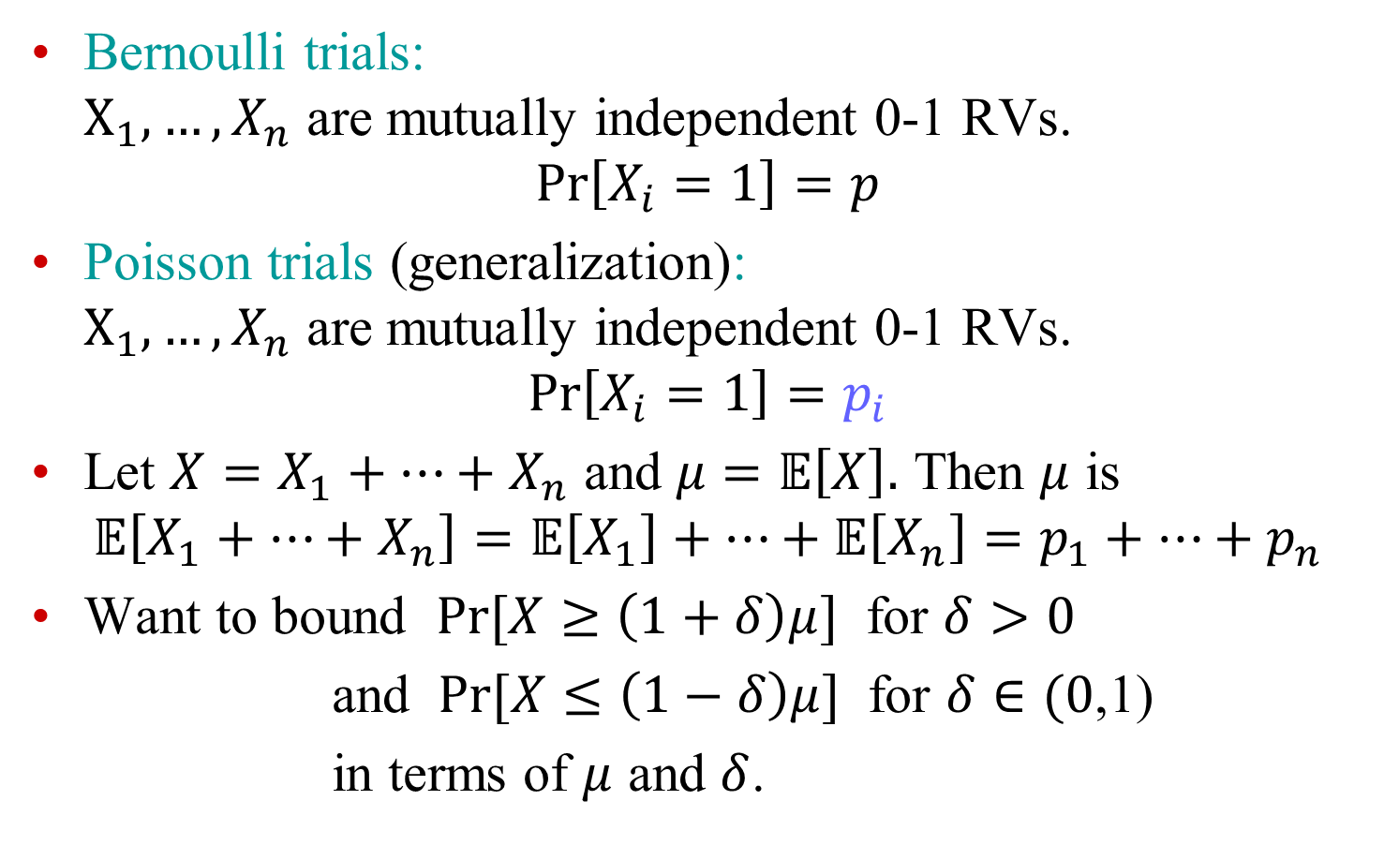

Sums of independent RVs
Bernoulli trials: $X_{1},…, X_{n}$ are mutually independent 0-1 RVs.
$$\operatorname{Pr}\left[X_{i}=1\right]=p$$
Poisson trials (generalization): $X_{1},…, X_{n}$ are mutually independent 0-1 RVs.
$$\operatorname{Pr}\left[X_{i}=1\right]=p_{i}$$
Let $X=X_{1}+…+X_{n}$ and $μ=𝔼\left[X\right].$ Then $μ$ is
$$𝔼\left[X_{1}+…+X_{n}\right]=𝔼\left[X_{1}\right]+…+𝔼\left[X_{n}\right]=p_{1}+…+p_{n}$$
Want to bound $Pr⁡[X≥\left(1+δ\right)μ]$ for $δ>0$
and $Pr⁡[X≤\left(1−δ\right)μ]$ for $δ∈(0$,1)
in terms of $μ$ and $δ$.
$≠$ Poisson RVs
Notes:
Bound in terms of $μ$ and $δ$

Slide 4
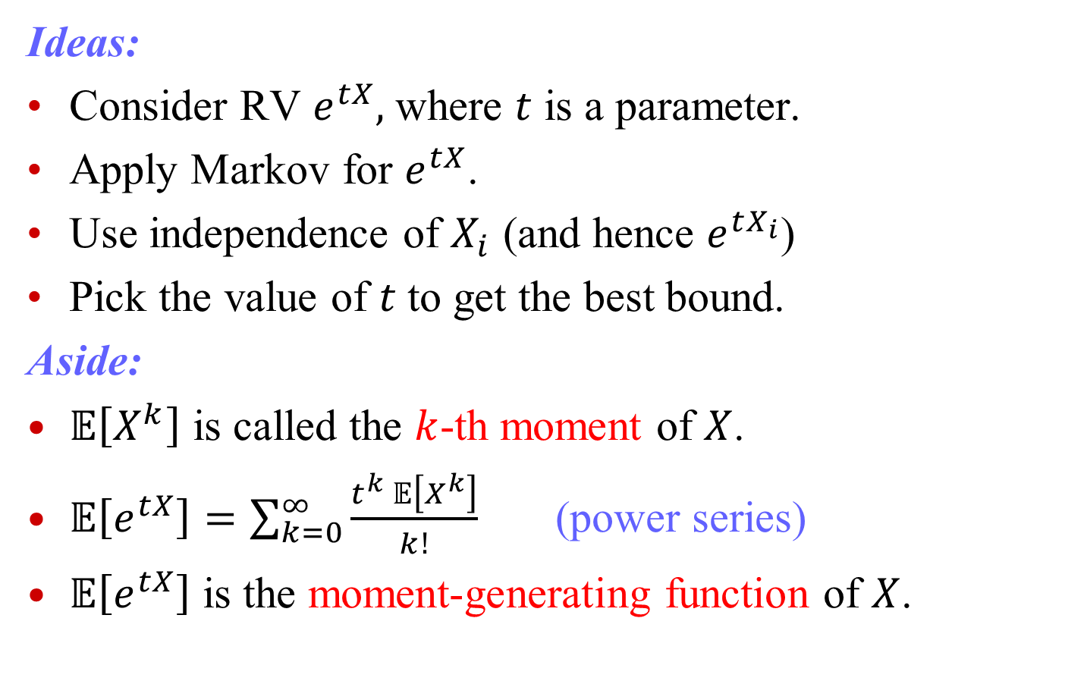
Obtaining the bounds
Ideas:
Consider RV $e^{tX},$ where $t$ is a parameter.
Apply Markov for $e^{tX}$.
Use independence of $X_{i}$ (and hence $e^{tX_{i}}$)
Pick the value of $t$ to get the best bound.
Aside:
$𝔼\left[X^{k}\right]$ is called the $k$-th moment of $X$.
$𝔼\left[e^{tX}\right]=\sum_{k=0}^{∞}{\frac{t^{k} 𝔼\left[X^{k}\right]}{k!}}$ (power series)
$𝔼\left[e^{tX}\right]$ is the moment-generating function of $X$.

Slide 5

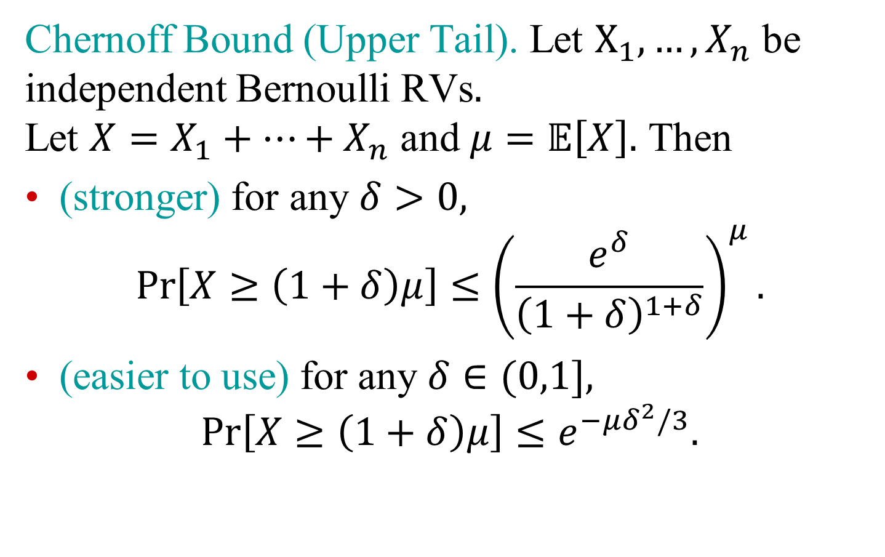
Sums of independent RVs
Chernoff Bound (Upper Tail). Let $X_{1},…, X_{n}$ be independent Bernoulli RVs$.$ Let $X=X_{1}+…+X_{n}$ and $μ=𝔼\left[X\right].$ Then
(stronger) for any $δ>0,$
$$\operatorname{Pr}\left[X≥\left(1+δ\right)μ\right]≤{\left(\frac{e^{δ}}{{\left(1+δ\right)}^{1+δ}}\right)}^{μ}.$$
(easier to use) for any $δ∈(0,1],$
$$\operatorname{Pr}\left[X≥\left(1+δ\right)μ\right]≤e^{−μδ^{2}/3}.$$

Slide 6
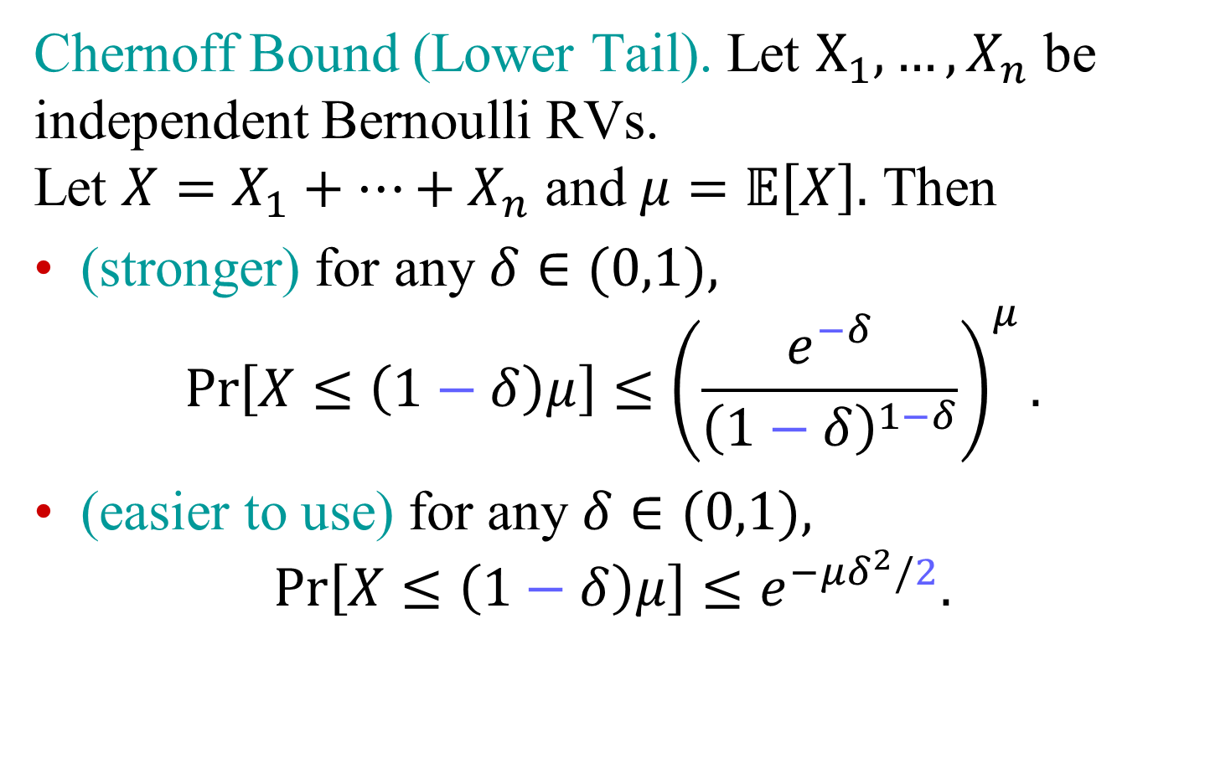
Sums of independent RVs
Chernoff Bound (Lower Tail). Let $X_{1},…, X_{n}$ be independent Bernoulli RVs. Let $X=X_{1}+…+X_{n}$ and $μ=𝔼\left[X\right].$ Then
(stronger) for any $δ∈(0,1),$
$$\operatorname{Pr}\left[X≤\left(1−δ\right)μ\right]≤{\left(\frac{e^{−δ}}{{\left(1−δ\right)}^{1−δ}}\right)}^{μ}.$$
(easier to use) for any $δ∈(0,1),$
$$\operatorname{Pr}\left[X≤\left(1−δ\right)μ\right]≤e^{−μδ^{2}/2}.$$

Slide 7
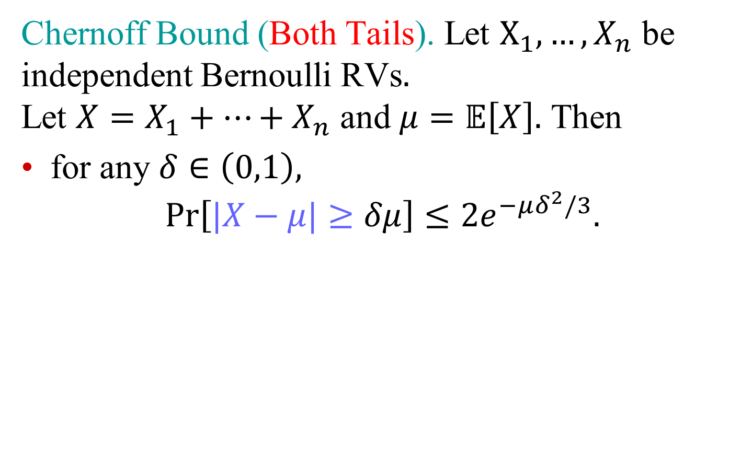
Sums of independent RVs
Chernoff Bound (Both Tails). Let $X_{1},…, X_{n}$ be independent Bernoulli RVs$.$ Let $X=X_{1}+…+X_{n}$ and $μ=𝔼\left[X\right].$ Then
for any $δ∈\left(0,1\right),$
$$\operatorname{Pr}\left[|X−μ|≥δμ\right]≤{2e}^{−μδ^{2}/3}.$$

Slide 8
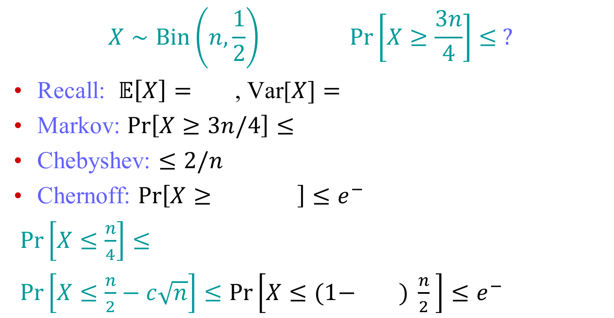
Exercise
$$X∼Bin\left(n,\frac{1}{2}\right) \operatorname{Pr}\left[X≥\frac{3n}{4}\right]≤ ?$$
Recall: $𝔼\left[X\right]=$ , Var[$X]=$
Markov: $\operatorname{Pr}\left[X≥3n/4\right]≤$
Chebyshev: $≤2/n$
Chernoff: $\operatorname{Pr}\left[X≥ \right]≤e^{−}$
$\operatorname{Pr}\left[X≤\frac{n}{4}\right]≤$
$\operatorname{Pr}\left[X≤\frac{n}{2}−c\sqrt{n}\right]≤\operatorname{Pr}\left[X≤(1− ) \frac{n}{2} \right]≤e^{−}$
Notes:
5/2

Slide 9
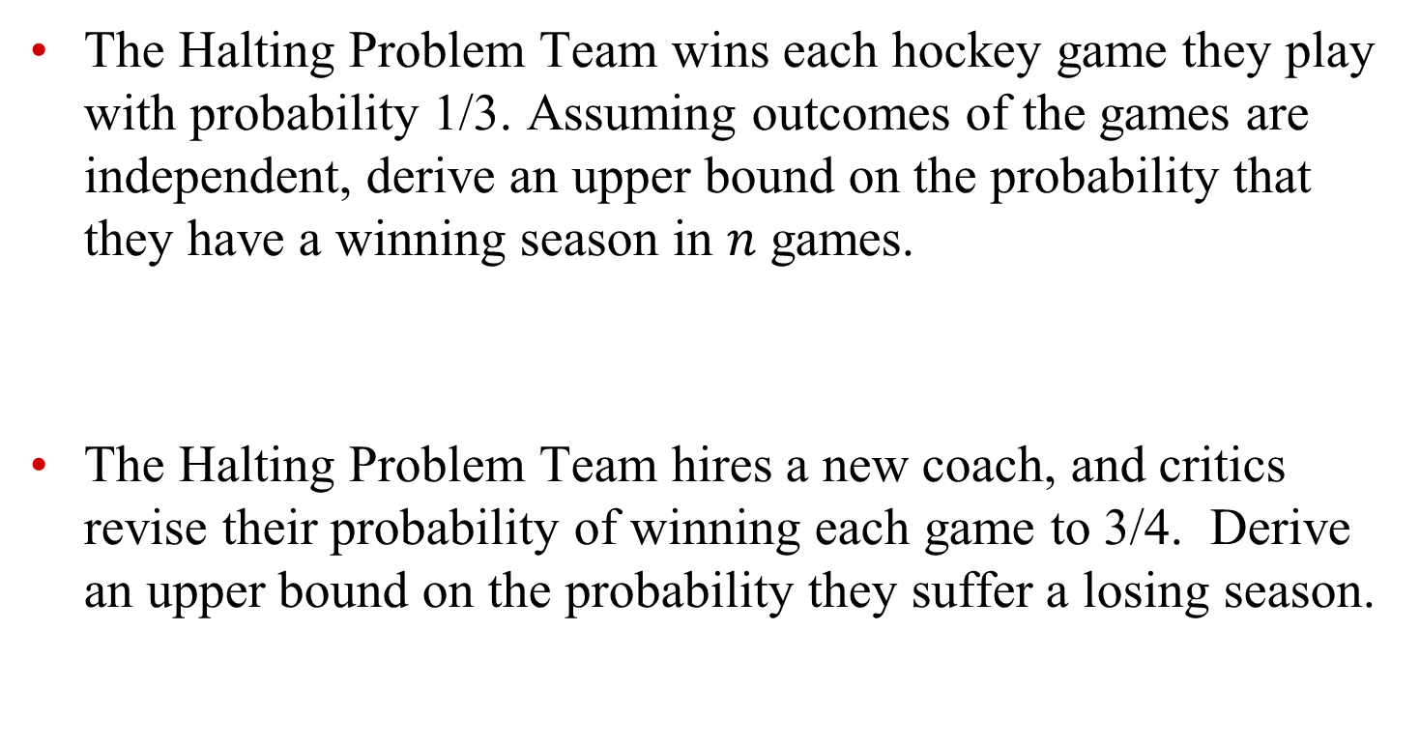
Exercise 2
The Halting Problem Team wins each hockey game they play with probability 1/3. Assuming outcomes of the games are independent, derive an upper bound on the probability that they have a winning season in $n$ games.
The Halting Problem Team hires a new coach, and critics revise their probability of winning each game to 3/4. Derive an upper bound on the probability they suffer a losing season.
Notes:
5/2

